Slide 1


ECEN 404: Final Presentation Team 31 Members: Martin Rennaker Grant Franklin Yarentzy Magallanes
Sponsor: Rohith Kumar
TA: Rohith Kumar
Notes:
Howdy! We Chilly dogs our team members consist of Grant Franklin, Martin Rennaker, and me Yarentzy Magallanes. Our sponsor and TA is Rohith Kumar and this is our Final ECEN 404 Presentation

Slide 2



Project Overview
Problem Statement
A car parked outside on a sunny, 95-degree
day can reach temperatures of up to 117
degrees Fahrenheit in just 30 minutes.
Approximately 100 dogs die in vehicles from heat exhaustion per year according to the AVMA.
Notes:
Leaving your pet inside a vehicle unattended is dangerous. But just how dangerous? Well to give you insight, A car parked outside on a sunny, 95-degree Fahrenheit day can reach temperatures of up to 117 degrees Fahrenheit in just 30 minutes.
​

Slide 3
Solution
Provide ideal cabin conditions to allow your pet to safely stay unattended in a vehicle.
Does not rely on the battery or motor of your vehicle​
Receive real time ambient and cabin temperature readings​
Set a desired output temperature through the Chilly dog phone application​
Receive alerts for low battery and extreme temperature conditions
Notes:
***We, the chilly dogs, have created a device to keep your cabin cool while you are away and assure the safety of your pet.​
***The chilly dog is a battery powered car A/C system. that can cool the inside of your vehicle without relying on the motor of your car or its battery.​
***Chilly Dog users will be able to receive real time temperature reading of the ambient and cabin temperature, adjust the desired output temperature using the chilly dog phone application, and even receive alerts when the device has low battery or conditions in the cabin become unfit for the pet. ​
​

Slide 4
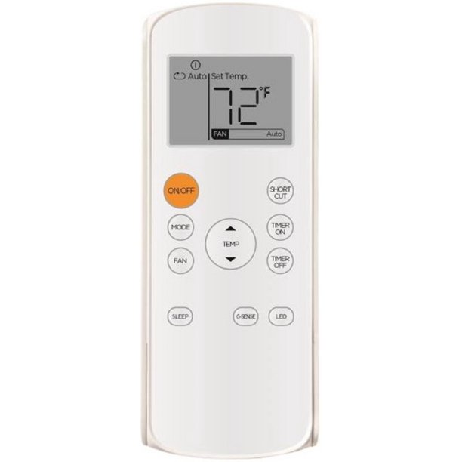
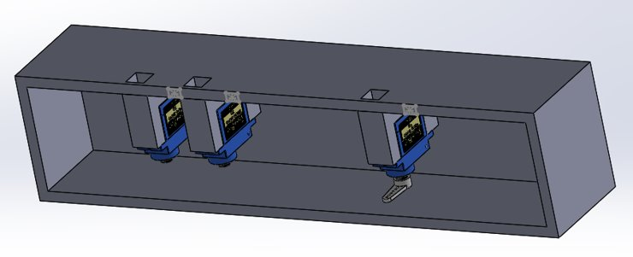
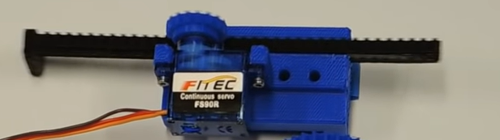
Controlling VAC
Attempts:
Arduino Infrared Remote
Unsupported protocol
Circular motion servo motor
Low accuracy (6/10)
Unstable
Solution:
Linear Actuator
Notes:
We will first dive into controlling the VAC. A lot of work was put into this aspect as it was a process of trial and error. First, I attempted to mimic the remote control with the Arduino by decoding the Infrared signals. This led to a dead end as I was unable to find any information on the protocol the specific VAC remote used. I them tried a configuration of mechanically pressing the buttons to finally determine the best solution. And this was done using vertical actuators like the one we see here. With this set up I am able to accurately and consistently control the VAC unit using the PWM pins on the Arduino.
After creating and verifying a prototype with wood, I have ordered the 3d print out and will be intalling it this week.

Slide 5
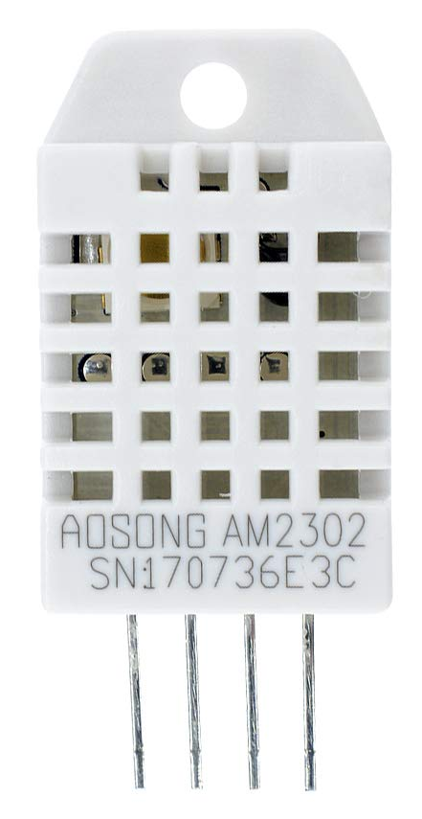
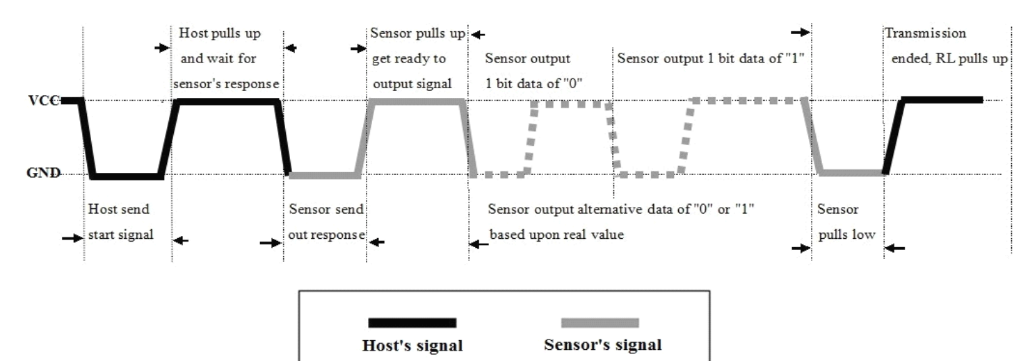
DHT22 Temperature and Humidity Sensor
Tested:
Accuracy +-0.5 C
Relative Accuracy +-0.1 C
Timely Readings 5 sec
Coded:
Signal interchange between sensor and Arduino
Notes:
Next, we will talk about the functionality and features of my code. At a very highlevel walk through. I have set up and initialized 2 temperature sensors that will take in readings every 5 seconds. The sensors used where the DHT22 Temperature sensors with a +-0.5 degree Celsius accuracy which was verified by comparing it to an ambient temperature sensor. The two specific sensors I used were checked against each other and found an inaccuracy if any of 0.1 degree C.

Slide 6
Battery Percentage User Command
Scenarios
Stand alone (Steady state)
Charging (VAC off)
VAC on
Charging and VAC on
EPROM to store temperature setting
Battery Voltage | Battery % | Stepped Down Voltage | Arduino Digital
12.846 | 100 | 4.1592 | 856
12.6811 | 50 | 4.144 | 804
12.1422 | 5 | 3.932 | 756
Notes:
It will also constantly monitor the battery life of the device through the ADC pin and send that data to the app. This function was broken up into 4 scenarios. Measurements were taken for when the battery is stand alone, when the battery is charging, when the AC is running, and When both are in effect to accurately reflect the battery percentage of the device as it is a very important aspect of keeping your pet safe.
It will continue doing this until a command is received from the user at which point it will service the command. The EPROM of the Arduino is being used to keep history of the last temperature setting.

Slide 7
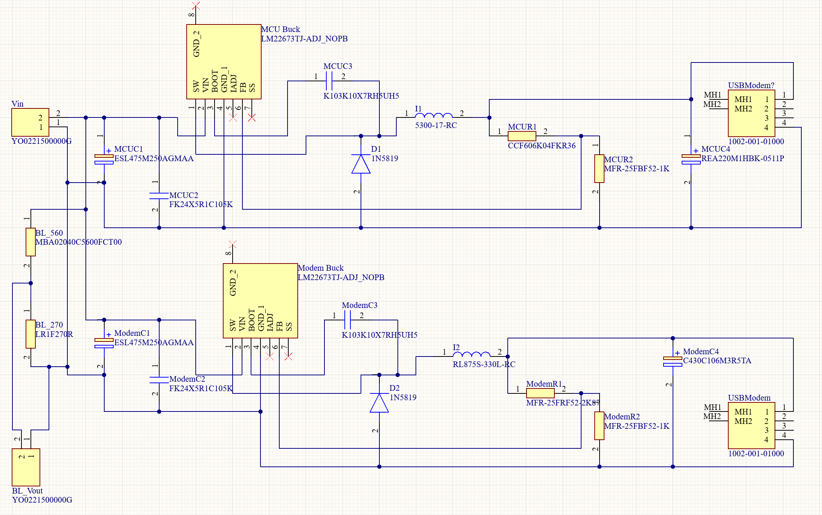
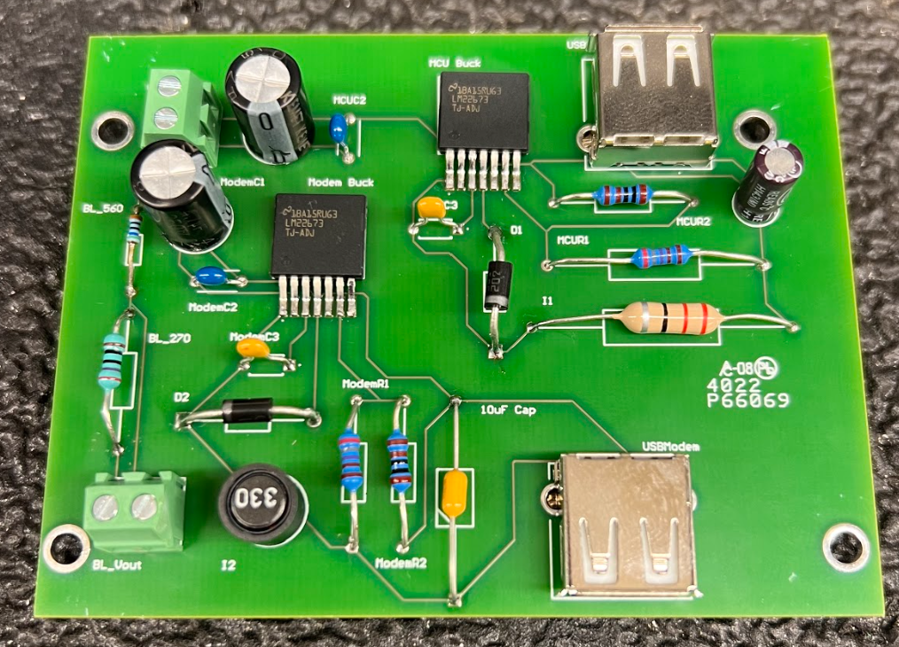
Grant Franklin
Design: PCB with battery voltage divider and 2 buck regulator circuits

Slide 8
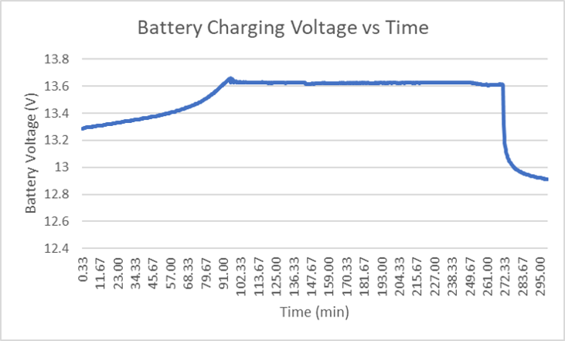
Grant Franklin
Testing/Validation:
PCB line/load tests
Battery charging/discharging
Servomotor converter validation
Battery life voltage divider output
MCU Line/Load Tests​
Modem Line/Load Tests​
Battery Charging Data

Slide 9
Grant Franklin
Challenges and Solutions
Challenge: Connection to MCU is 5V-9V because of USB-A
Solution: Changed resistor values on the PCB so the nominal output of the buck circuit is 5V so the cable can step up the voltage to 9V for the Arduino
Challenge: Running into dead batteries when trying to move from 100Ah to 33Ah
Solution: Tested multiple batteries and chose the one with the most reliable charging and discharging

Slide 10
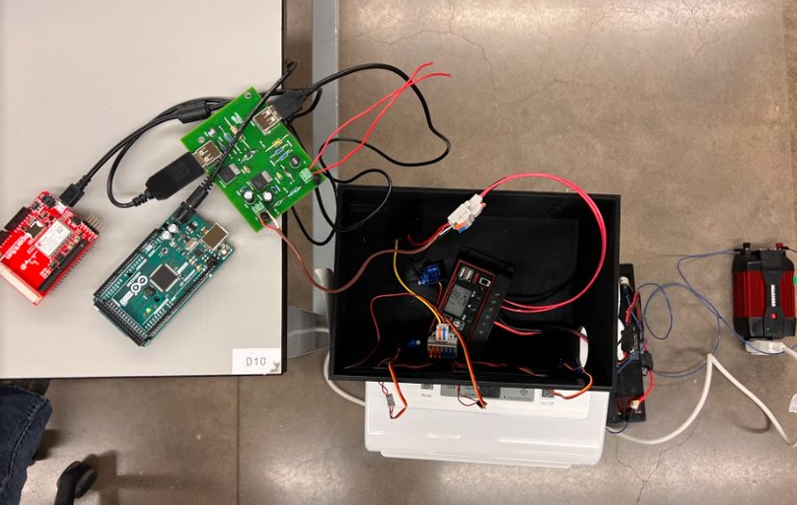
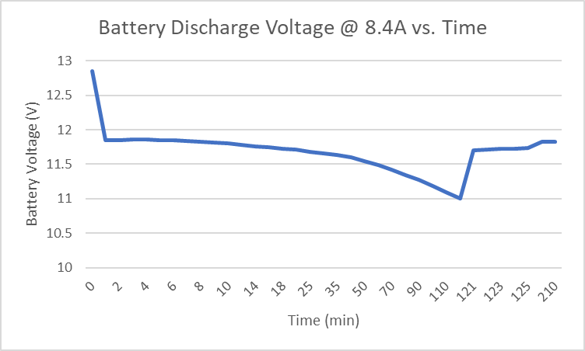
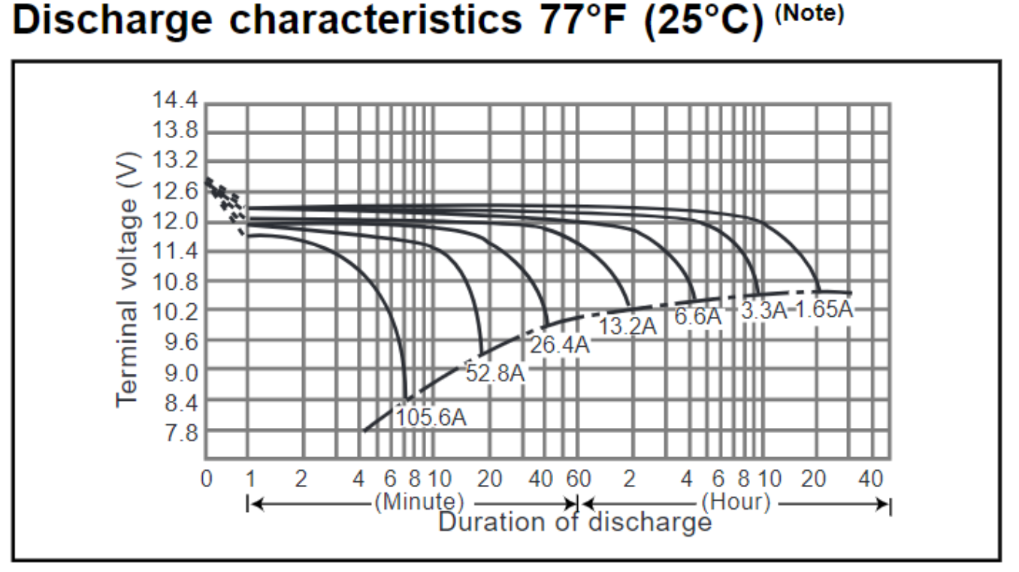
Grant Franklin
Integrated System Results
Battery life for full system load
System will run for 90 minutes
Full system can run with full load
Spike due to load being removed from battery

Slide 11
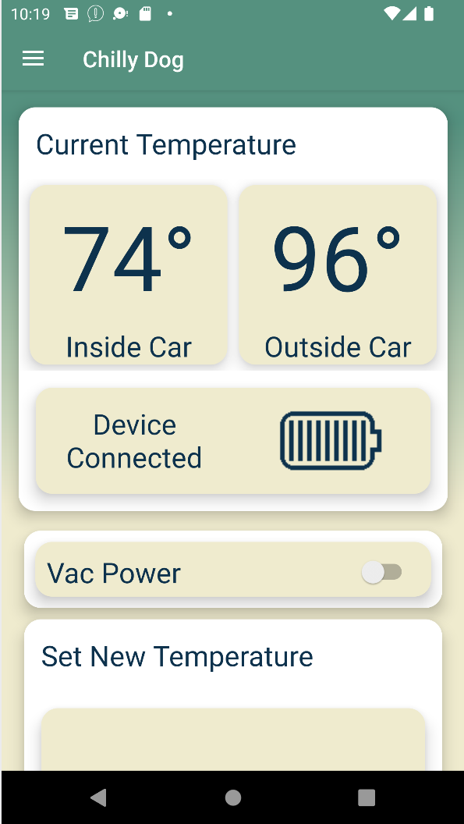
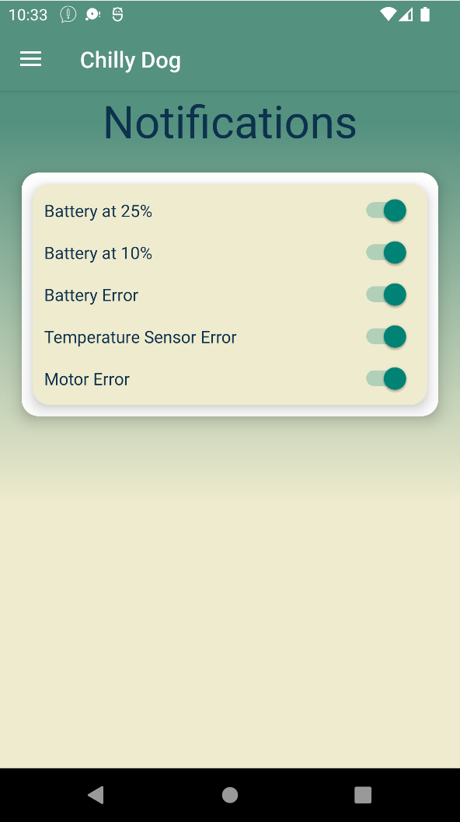
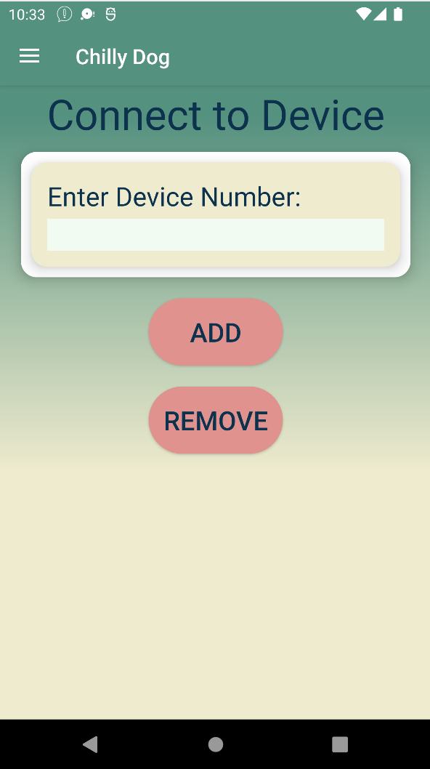
Martin Rennaker
App
Main interface with system for user
Shows in car and out of car temp and battery life
Allows user to remotely send the desired temperature and power on or off the device
Toggle which notifications the user wishes to receive
Connect new devices and remove old ones
Notes:
Toggle on and off to give the user control features

Slide 12
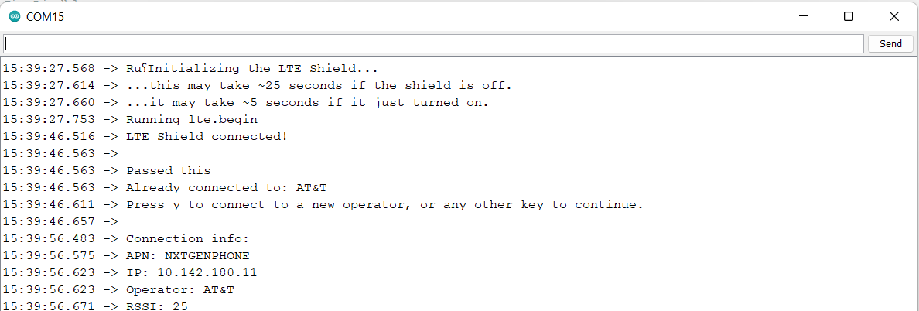
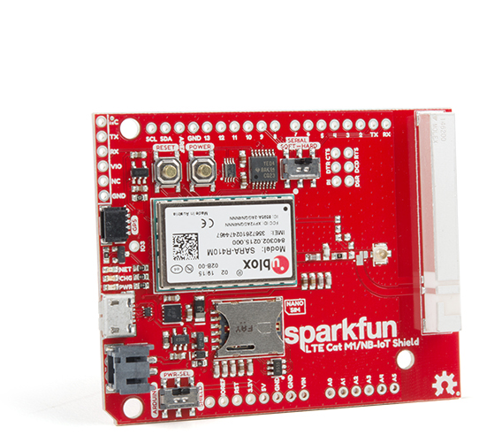
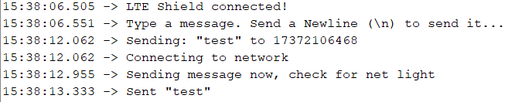
Martin Rennaker
Modem
Started by using 3g, those towers came down late 2021
Switched to Waveshare Sim 7600 pi hat, used this through the end of 403 and beginning of 404
Couldn't get Waveshare's UART working with the arduino
Switched to Sparkfun 4g arduino hat
Notes:
Show pictures! Of the all the different screens for the app

Slide 13
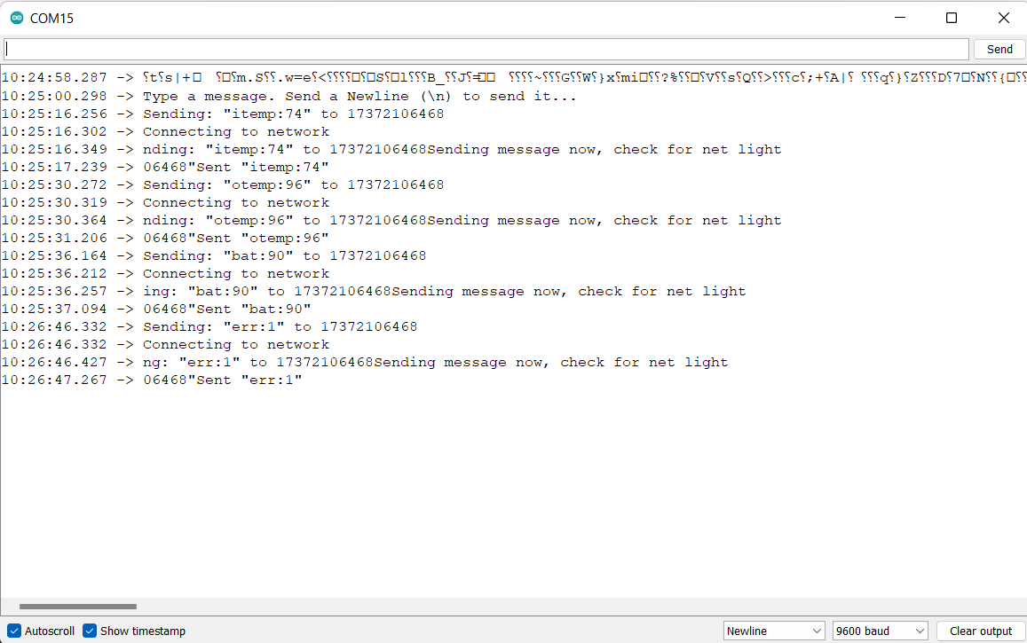
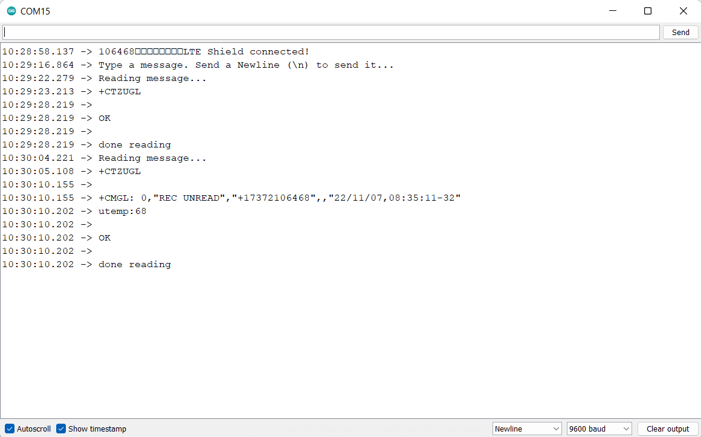
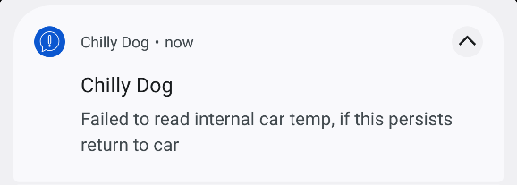
Martin Rennaker
Results
Sending to the app works great
Updates temperatures and battery percentage
Sends warnings that the app uses to send a notification to the user
Sending from the app is the trouble area
Modem isn't consistently receiving texts making it hard to test
When the modem receives the text the arduino can read it
Notes:
Show pictures! Of the all the different screens for the app

Slide 14
Conclusion
Issues encountered
MCU changed from PIC to Arduino MEGA to Arduino Uno
Battery changed from 100Ah to 33Ah
Modem changed from Waveshare 7600 to Sparkfun Sara R4
Current status of project
System can run for a sufficient length of time with battery as power source
MCU can correctly read the correct battery voltage
In progress
Validate system's ability to run while solar panel is charging
Improve consistency of the modem's ability to receive texts
Validate the consistency of the push buttons

Slide 15
Questions?

